Slide 1
Computer Organization and Architecture
MIPS Architecture
Floating Point Number Representation
Conversion of C Programs to MIPS Assembly Language
Fall, 2020

Slide 2
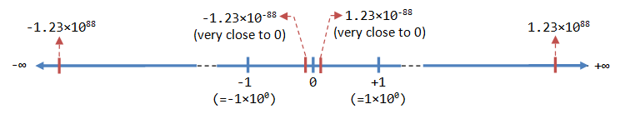
Floating-Point Number Representation
A floating-point number (or real number) can represent a very large (1.23×10^88) or a very small (1.23×10^-88) value.
It could also represent very large negative number (-1.23×10^88) and very small negative number (-1.23×10^88), as well as zero, as illustrated:

Slide 3
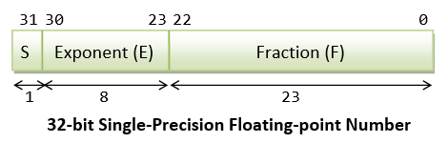
IEEE-754 32-bit Single-Precision Floating-Point Numbers
In 32-bit single-precision floating-point representation:
The most significant bit is the sign bit (S), with 0 for positive numbers and 1 for negative numbers.
The following 8 bits represent exponent (E).
The remaining 23 bits represents fraction (F).

Slide 4
Exercise 1:
Write a program to convert Fahrenheit to Celsius using the formula below:
Fahrenheit = Celsius * 9.0 / 5.0 + 32.0;
Write a function for this temperature conversion. Celsius value is be passed into the function as single-precision data and Fahrenheit value is returned also in single-precision. Remember to follow all the floating-point function conventions.
Exercise 2:
This exercise will familiarize you with floating point multiplication and division instructions. In this part you have to write a complete ‘UET Peshawar GPA calculator” program. The program should calculate GPA for a quarter only. When your program starts it should ask the unit and GPA in each of the four courses taken in the quarter. It should store all this information in memory. It should then compute the quarter GPA for the person and display it to the user. You should have a separate Compute GPA function which loads all necessary info from memory and computes the GPA. Note that you will need syscalls to input and output floats to the user. For this purpose you will have to refer to the old handout for the service code of these system calls. A more detailed instruction set is given at the end of this handout and may be useful for this exercise.
Exercise 3: Design a calculator that can perform addition, subtraction, multiplication and division on integer as well as floating point numbers.

Slide 5
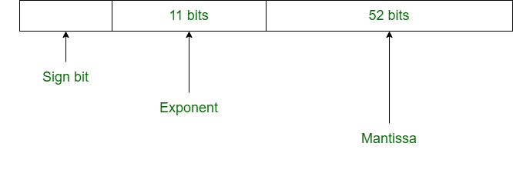
Double-Precision Floating-Point Numbers
Double-precision floating-point format is a computer number format, usually occupying 64 bits in computer memory
Double-precision floating-point represents a wide dynamic range of numeric values by using a floating radix point.
Floating point is used to represent fractional values, or when a wider range is needed than is provided by fixed point (of the same bit width), even if at the cost of precision. Double precision may be chosen when the range or precision of single precision would be insufficient.

Slide 6
System Call Services for Floating-Point Numbers
Following syscall service numbers (passed in $v0) to print and read single-precision and double-precision floating-point numbers:
Service $v0 Arguments Result Print Float 2 $f12
Print Double 3 $f12
Read Float 6 Float is returned in $f0 Read Double 7 Double is returned in $f0

Slide 7
Double-Precision Floating-Point Numbers
MIPS also has hardware for double precision (64 bit) floating point operations.
There are 16 pairs, named $f0, $f2, ... , $f30. Only the even numbered register is specified in a double precision instruction.
add.d $f0, $f2, $f4 # {$f0,$f1} = { $f2, $f3 } + { $f4, $f5 }
add.d $f0, $f2, $f5 # Illegal in MIPS 32

